Slide 1
CPU Schedulers:
An Overview and Implementation
By Tyler Bennett, Nicholas Brzoska, Kevin Huang, and Evan Michaels

Slide 2
Recap: What is a CPU Scheduler?
What do they do? How do they work? How do they integrate with the rest of the OS?

Slide 3
What is a CPU Scheduler? (1)
Schedules and manages the execution of the tasks that a CPU needs to perform
The reason we schedule is to maximize the efficiency of the CPU
We want to perform as many tasks as possible, as quick as possible
Is responsible for the allocation of time, space, and memory

Slide 4
What is a CPU Scheduler? (2)
In order to solve this optimization problem, OS designers use algorithms to control the CPU scheduler
The algorithm may take into account many different factors, such as:
Execution time
Arrival time
Priorities
(For our purposes, we’ll assume that all tasks only use the CPU and no I/O)

Slide 5
How to Measure CPU Schedulers
Here are some statistics we can use to measure our algorithm:
Arrival time = t_{arrival} = The time at which the job first comes into the system
Start time = t_{start} = The time at which the job first runs
Completion time = t_{completion} = The time at which the job stops running
Burst time = t_{burst} = The amount of time required by the job to complete

Slide 6
CPU Scheduler Equations
And here are some equations that relate the stats we discussed:
Turnaround time = t_{turnaround} = t_{completion} – t_{arrival}
Measures how long it takes a job to finish once it arrives
Response time = t_{response} = t_{start} – t_{arrival}
Measures how long it first takes a job to get to the CPU once it arrives
Waiting time = t_{wait} = t_{turnaround} – t_{burst}
Measures the total amount of time that a job spends not running

Slide 7
CPU Scheduler Objectives
In any optimization problem, your goal is to either maximize or minimize certain criteria. For our purposes, this could be:
Maximizing throughput — the number of tasks that execute per time unit
Minimizing response and waiting time – perhaps setting a lower bound that you hope not to exceed
Maximizing fairness of CPU allocation – a few jobs should not dominate all of the CPU time
Minimizing turnaround time

Slide 8
CPU Scheduler Algorithms
How can we design our system to maximize the rate at which programs?

Slide 9

First In, First Out (FIFO)
This is arguably the simplest scheduling algorithm
Jobs are run in the exact same order they arrive
Can be implemented with just a single queue

Slide 10
FIFO Advantages/Disadvantages
Advantages | Disadvantages
- Simple to implement because it doesn’t consider priority or runtime (when scheduling) - Computationally non intensive | - One job running slowly can slow down the whole system - This is known as the “convoy effect”

Slide 11
FIFO Example
Process | Priority | Arrival Time | Burst Time
P1 | 1 | 0 | 20
P2 | 5 | 3 | 4
P3 | 3 | 7 | 3

Slide 12
FIFO Example
Process | Priority | Arrival Time | Burst Time
P1 | 1 | 0 | 20
P2 | 5 | 3 | 4
P3 | 3 | 7 | 3
P1 (20)
t=0
t=3
(P2 arrives)
t=7
(P3 arrives)

Slide 13
FIFO Example
Process | Priority | Arrival Time | Burst Time
P1 | 1 | 0 | 20
P2 | 5 | 3 | 4
P3 | 3 | 7 | 3
P1 (20)
P2 (4)
t=0
t=3
(P2 arrives)
t=7
(P3 arrives)
t=20

Slide 14
FIFO Example
Process | Priority | Arrival Time | Burst Time
P1 | 1 | 0 | 20
P2 | 5 | 3 | 4
P3 | 3 | 7 | 3
P1 (20)
P2 (4)
P3 (3)
t=0
t=3
(P2 arrives)
t=7
(P3 arrives)
t=20
t=24
t=27

Slide 15
FIFO Example: Stats
Avg turnaround time = ((20-0) + (24-3) + (27-7)) / 3 = 20.33
Avg response time = ((0-0) + (20–3) + (24-7)) / 3 = 11.33
Avg waiting time = ((20–20) + (21 - 4) + (20 - 3)) / 3 = 11.33
P1 (20)
P2 (4)
P3 (3)
t=0
t=3
(P2 arrives)
t=7
(P3 arrives)
t=20
t=24
t=27

Slide 16
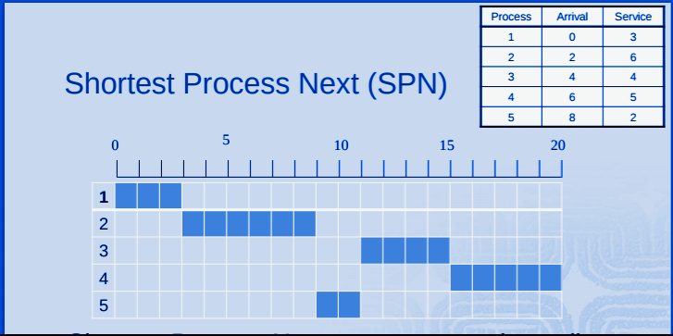
Shortest Job First
If there is only one job in the queue, it is run
If there are multiple jobs waiting, the job with the shortest burst time will always run next

Slide 17
Shortest Job First Advantages/Disadvantages
Advantages | Disadvantages
- Ensures there are the fewest number of tasks to complete at all times - Has the minimum average waiting time (making it better for long term scheduling) | - Allows for “starvation” of very long tasks, since they are the least likely to run - The algorithm requires that you can accurately predict the burst time of every job

Slide 18
SJF Example
Process | Priority | Arrival Time | Burst Time
P1 | 3 | 0 | 8
P2 | 2 | 5 | 2
P3 | 6 | 7 | 12

Slide 19
SJF Example
Process | Priority | Arrival Time | Burst Time
P1 | 3 | 0 | 8
P2 | 2 | 5 | 2
P3 | 6 | 7 | 12
P1 (8)
t=0
t=5
(P2 arrives)
t=7
(P3 arrives)

Slide 20
SJF Example
Process | Priority | Arrival Time | Burst Time
P1 | 3 | 0 | 8
P2 | 2 | 5 | 2
P3 | 6 | 7 | 12
P1 (8)
P2 (4)
t=0
t=5
(P2 arrives)
t=7
(P3 arrives)
t=8

Slide 21
SJF Example
Process | Priority | Arrival Time | Burst Time
P1 | 3 | 0 | 8
P2 | 2 | 5 | 2
P3 | 6 | 7 | 12
P1 (8)
P2 (2)
P3 (12)
t=0
t=5
(P2 arrives)
t=7
(P3 arrives)
t=8
t=10
t=22

Slide 22
SJF Stats
Avg turnaround time = ((8-0) + (10-5) + (22-7)) / 3 = 9.33
Avg response time = ((0-0) + (8–5) + (10-7)) / 3 = 2
Avg waiting time = ((8-8) + (5-2) + (15-12)) / 3 = 2
P1 (8)
P2 (2)
P3 (12)
t=0
t=5
(P2 arrives)
t=7
(P3 arrives)
t=8
t=10
t=22

Slide 23
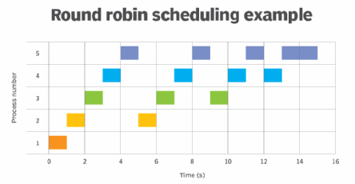
Round Robin
Gives a set amount of time to each task, called the “time quantum”
Cycles through tasks in order of arrival until each task has reached completion
Can once again be implemented with a queue

Slide 24
Round Robin Advantages/Disadvantages
Advantages | Disadvantages
- Gives equal attention to all tasks | - A small task can get buried and ignored if there are many tasks - Thus, small tasks can take a long time to finish, slowing down throughput

Slide 25
Round Robin Example
(Time Quantum = 3)
Process | Arrival Time | Burst Time | Time Remaining
P1 | 0 | 9 | 9
P2 | 0 | 7 | 7
P3 | 0 | 3 | 3

Slide 26
Round Robin Example
(Time Quantum = 3)
Process | Arrival Time | Burst Time | Time Remaining
P1 | 0 | 9 | 6
P2 | 0 | 7 | 7
P3 | 0 | 3 | 3
P1
t=0 (P1-3 arrive)

Slide 27
Round Robin Example
(Time Quantum = 3)
Process | Arrival Time | Burst Time | Time Remaining
P1 | 0 | 9 | 6
P2 | 0 | 7 | 4
P3 | 0 | 3 | 3
P1
P2
t=0 (P1-3 arrive)
t=3

Slide 28
Round Robin Example
(Time Quantum = 3)
Process | Arrival Time | Burst Time | Time Remaining
P1 | 0 | 9 | 6
P2 | 0 | 7 | 4
P3 | 0 | 3 | 0
P1
P2
P3
t=0 (P1-3 arrive)
t=3
t=6

Slide 29
Round Robin Example
(Time Quantum = 3)
Process | Arrival Time | Burst Time | Time Remaining
P1 | 0 | 9 | 3
P2 | 0 | 7 | 4
P3 | 0 | 3 | 0
P1
P2
P3
P1
t=0 (P1-3 arrive)
t=3
t=6
t=9

Slide 30
Round Robin Example
(Time Quantum = 3)
Process | Arrival Time | Burst Time | Time Remaining
P1 | 0 | 9 | 3
P2 | 0 | 7 | 1
P3 | 0 | 3 | 0
P1
P2
P3
P1
P2
t=0 (P1-3 arrive)
t=3
t=6
t=9
t=12

Slide 31
Round Robin Example
(Time Quantum = 3)
Process | Arrival Time | Burst Time | Time Remaining
P1 | 0 | 9 | 0
P2 | 0 | 7 | 1
P3 | 0 | 3 | 0
P1
P2
P3
P1
P2
P1
t=0 (P1-3 arrive)
t=3
t=6
t=9
t=12
t=15

Slide 32
Round Robin Example
(Time Quantum = 3)
Process | Arrival Time | Burst Time | Time Remaining
P1 | 0 | 9 | 0
P2 | 0 | 7 | 1
P3 | 0 | 3 | 0
P1
P2
P3
P1
P2
P1
P2
t=0 (P1-3 arrive)
t=3
t=6
t=9
t=12
t=15
t=18
t=19

Slide 33
Round Robin Stats
(Time Quantum = 3)
Avg turnaround time = ((18-0) + (19-0) + (9-0)) / 3 = 15.33
Avg response time = ((0-0) + (3–0) + (6-0)) / 3 = 3
Avg waiting time = ((18-9) + (19-7) + (9-3)) / 3 = 9
P1
P2
P3
P1
P2
P1
P2
t=0 (P1-3 arrive)
t=3
t=6
t=9
t=12
t=15
t=18
t=19

Slide 34
Priority-Based Scheduling
Another trick designers often use to ensure that programs aren’t starved is assigning “priorities”
Tasks with higher priorities should (generally) run before programs with lower priorities
This isn’t the only factor of course
Priority may be incorporated into algorithms in all sorts of ways
In other words, there isn’t one right or wrong way to use priority

Slide 35
Priority-Based Scheduling
Advantages/Disadvantages
Advantages | Disadvantages
- Gives more attention to more important tasks - This allows for better resource management | - On the other hand, smaller tasks may now be at risk of starvation (this can be fixed with “aging”) - Every job must accurately be assigned a priority

Slide 36
Multi-Core Scheduling
What happens when we introduce multiple cores? How can our scheduling algorithm take advantage of this?

Slide 37
Partitioned Multi-Core Scheduling
In partitioned scheduling, each job is assigned to its own core
This can lead to cores having unequal workloads depending on the jobs’ specifications
This is because there is a lack of synchronization between cores
To frame it a different way, though, since no synchronization is needed, it’s easier to implement

Slide 38
Global Multi-Core Scheduling
In global scheduling, all cores share the same queue of jobs
This allows for more centralized decision making
It’s easier to balance the workload across all cores
However, it’s more complex than partitioned scheduling due to synchronization issues
Mutexes or other synchronization techniques are needed to prevent read/write issues from the queue

Slide 39
Advantages of Multi-Core Scheduling
Allows for more flexibility
Not every core has to use the same scheduling algorithm
The way in which jobs are distributed to cores may also be a factor in your algorithm
Distributes workload evenly across many workers
In this way, it’s a lot like multithreading
Most modern PC’s and laptops have a multicore CPU, so it’s necessary to adapt to this style

Slide 40
Our CPU Scheduler
How can we design our system to maximize the rate at which programs?

Slide 41
How Our Algorithm Works: High-Level
We simulate 4 “cores” using vector (queue) objects
Every time we add a new job, we compare the total runtimes of every core
The one with the minimum runtime is the one we choose
Each core contains 3 subqueues
These all run on simple FIFO algorithms
We then simulate a “program” using a class with attributes:
Burst time
Priority
From these, we calculate a “priority ratio” that’s used to determine which subqueue the job should be placed in

Slide 42
Example / Diagram
P18
(Burst = 6)
(Priority = 2)
Core 1
(Total Runtime = 17)
Core 2
(Total Runtime = 16)
Core 3
(Total Runtime = 13)
Core 4
(Total Runtime = 18)
P1 (Burst = 4)
P6 (Burst = 9)
P10 (Burst = 1)
P15 (Burst = 8)
P2 (Burst = 2)
P7 (Burst = 1)
P11 (Burst = 3)
P16 (Burst = 7)
P3 (Burst = 3)
P8 (Burst = 2)
P12 (Burst = 3)
P17 (Burst = 3)
P4 (Burst = 7)
P9 (Burst = 4)
P13 (Burst = 1)
P5 (Burst = 1)
P14 (Burst = 5)

Slide 43
Example / Diagram
P18
(Burst = 6)
(Priority = 2)
Core 3 has the least total runtime
Core 1
(Total Runtime = 17)
Core 2
(Total Runtime = 16)
Core 3
(Total Runtime = 13)
Core 4
(Total Runtime = 18)
P1 (Burst = 4)
P6 (Burst = 9)
P10 (Burst = 1)
P15 (Burst = 8)
P2 (Burst = 2)
P7 (Burst = 1)
P11 (Burst = 3)
P16 (Burst = 7)
P3 (Burst = 3)
P8 (Burst = 2)
P12 (Burst = 3)
P17 (Burst = 3)
P4 (Burst = 7)
P9 (Burst = 4)
P13 (Burst = 1)
P5 (Burst = 1)
P14 (Burst = 5)

Slide 44
Example / Diagram
P18
(Burst = 6)
(Priority = 2)
Core 3
(Total Runtime = 9)
Queue 1 (0 - 0.75) | Queue 2 (0.75 - 1.4) | Queue 3 (> 1.4)
P10 (Burst = 1)
P13 (Burst = 1)
P11 (Burst = 3)
P14 (Burst = 5)
P12 (Burst = 3)

Slide 45
Example / Diagram
P18
(Burst = 6)
(Priority = 2)
Priority Ratio =
(10 * p * p_{max}) / (b * b_{max}) = 0.67
Core 3
(Total Runtime = 9)
Queue 1 (0 - 0.75) | Queue 2 (0.75 - 1.4) | Queue 3 (> 1.4)
P10 (Burst = 1)
P13 (Burst = 1)
P11 (Burst = 3)
P14 (Burst = 5)
P12 (Burst = 3)

Slide 46
Example / Diagram
P18
(Burst = 6)
(Priority = 2)
Priority Ratio =
(10 * p * p_{max}) / (b * b_{max}) = 0.67
Core 3
(Total Runtime = 9)
Notes: p = priority, b = burst,
p_{max} = 6, b_{max} = 30
Queue 1 (0 - 0.75) | Queue 2 (0.75 - 1.4) | Queue 3 (> 1.4)
P10 (Burst = 1)
P13 (Burst = 1)
P11 (Burst = 3)
P14 (Burst = 5)
P12 (Burst = 3)

Slide 47
Example / Diagram
P18
(Burst = 6)
(Priority = 2)
Priority Ratio =
(10 * p * p_{max}) / (b * b_{max}) = 0.67
Core 3
(Total Runtime = 9)
Queue 1 (0 - 0.75) | Queue 2 (0.75 - 1.4) | Queue 3 (> 1.4)
P10 (Burst = 1)
P13 (Burst = 1)
P11 (Burst = 3)
P14 (Burst = 5)
P12 (Burst = 3)
P18 (Burst = 6)

Slide 48
Implementation
Does this algorithm actually work? How well does it perform?

Slide 49
How It’s Implemented
We chose to implement the program in C++
C++ gives us access to additional features like classes and vectors
Vectors are like arrays, but their size can change dynamically, allowing for more flexibility
These features also allowed us to avoid referencing issues that arise in multi-level programs
C++ classes are more powerful than C structs because they can define both attributes and methods

Slide 50
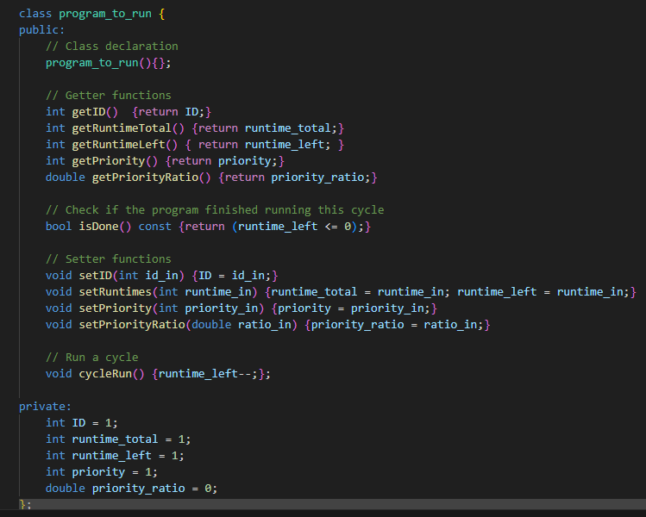
Code Explanation: program.h

Slide 51
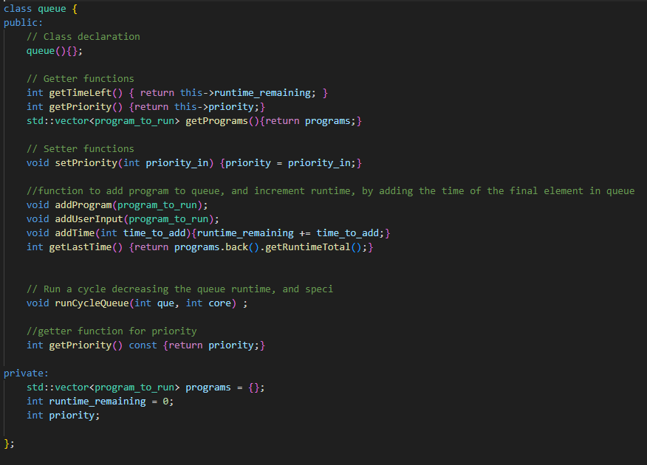
Code Explanation: core.h

Slide 52
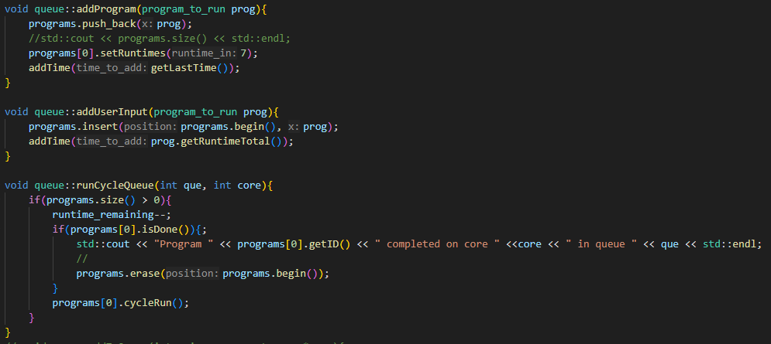
Code Explanation (core.cpp)

Slide 53
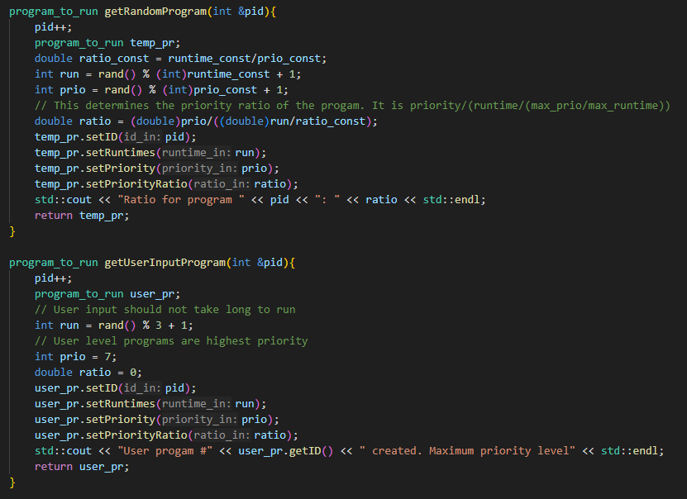
Code Explanation (OSsim.cpp, generating)

Slide 54
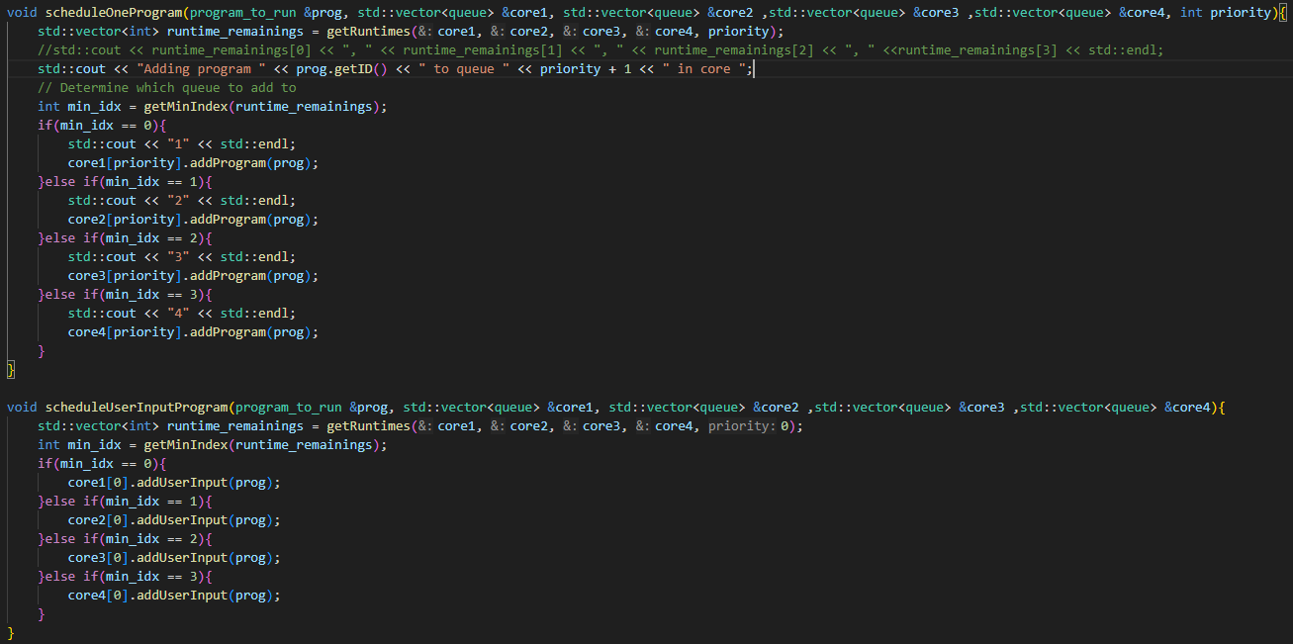
Code Explanation (OSsim.cpp, schedule once)

Slide 55
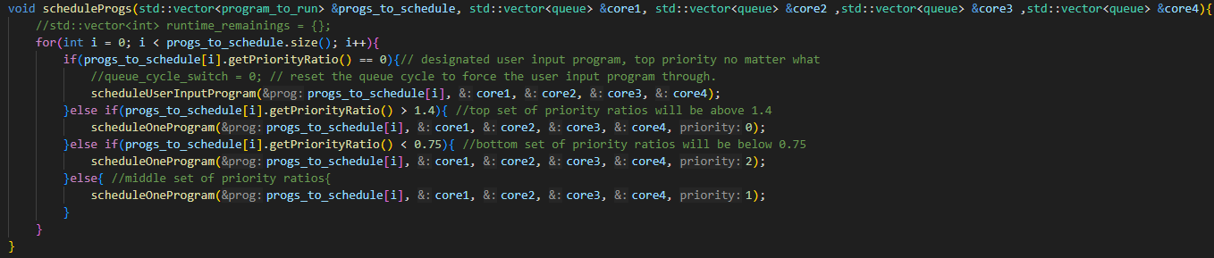
Code Explanation (OSsim.cpp, schedule all)

Slide 56
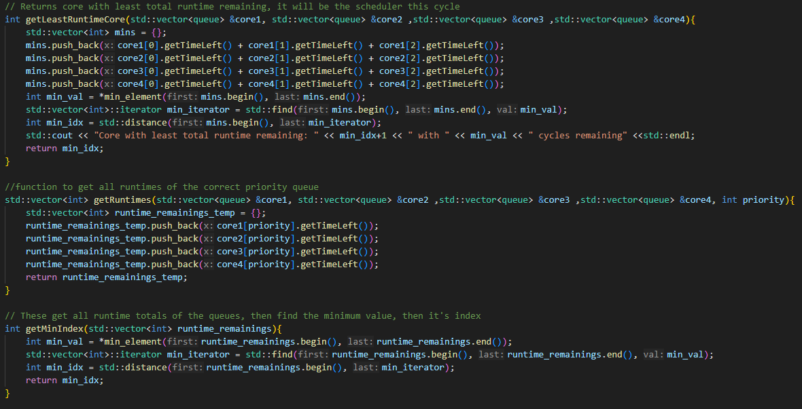
Code Explanation (OSsim.cpp, runtime)

Slide 57
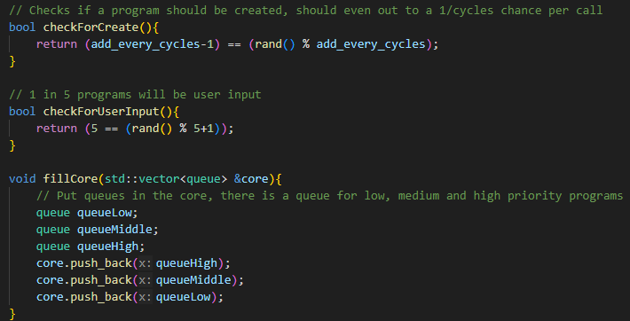
Code Explanation (OSsim.cpp, logic & cores)

Slide 58
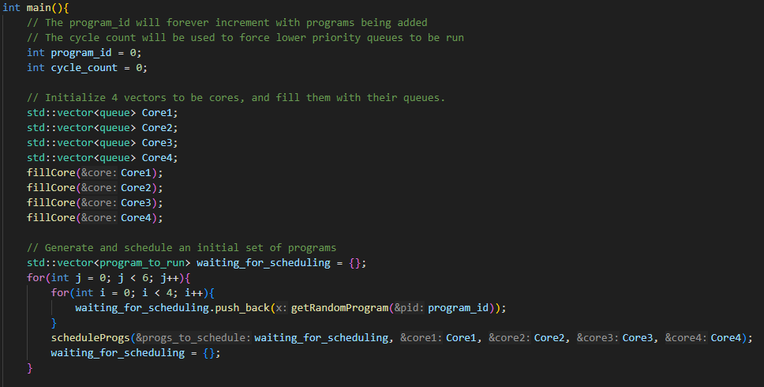
Code Explanation (OSsim.cpp, initialize main)

Slide 59
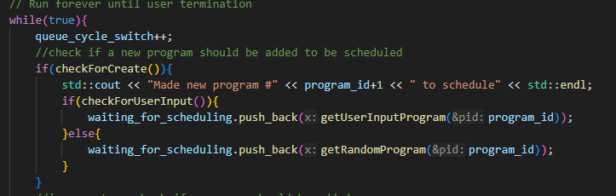
Code Explanation (OSsim.cpp, simulate scheduling)

Slide 60
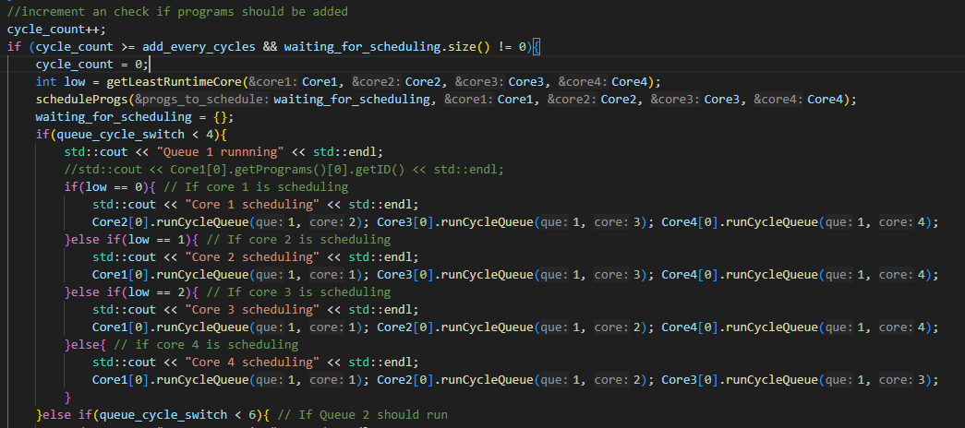
Code Explanation (OSsim.cpp, run & schedule)

Slide 61
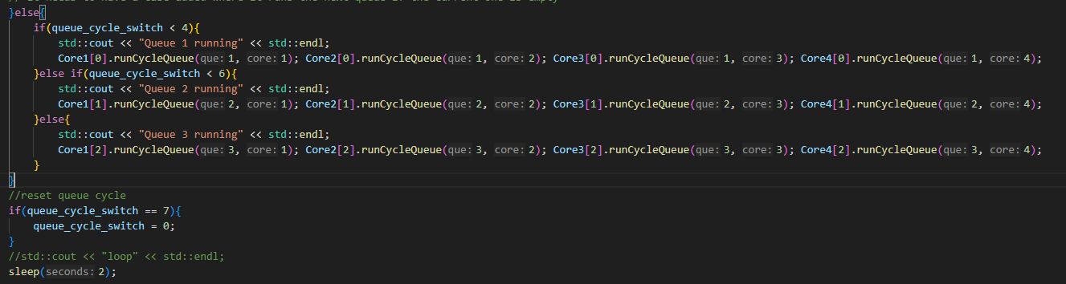
Code Explanation (OSsim.cpp, run without schedule)

Slide 62
Potential Improvements
It was difficult to implement
Had to simulate cores using vectors instead of a class
Sourced from issues with nested pass-by-reference
Wanted to have a different core handling different queues
Because of vectors, each time a program is scheduled, all total times to run queues must be accessed
Having the cores implemented this way led to more passing of references to functions rather than references in classes
Could use a non-FIFO algorithm in queues for more efficiency

Slide 63
Sources
https://www.geeksforgeeks.org/cpu-scheduling-in-operating-systems/
https://www.guru99.com/cpu-scheduling-algorithms.html
https://afteracademy.com/blog/what-is-burst-arrival-exit-response-waiting-turnaround-time-and-throughput/
https://cplusplus.com/reference/vector/vector/

